Slide 1
NAVAIR Aircrew Systems Industry Day
24th July 2019
Dr. James Sheehy, ST

Slide 2
Naval S&T Technology Flow
RDT&E
BA1
BA2
BA3
BA4
BA5
BA7
TRL 1 - 3
TRL 4 - 6
TRL 7
TRL 8
TRL 9
Materiel Solution
Analysis
Engineering & Manufacturing
Development
Production &
Deployment
Operations & Support
Technology Maturation and Risk Reduction
A
B
C
Initial Product/
Process Capability
Product/Process
Development
Product/Process
Insertion
Product/Process
Improvement & Sustainment
Discovery and Invention
DTRA and DARPA Programs
Sec 219 Basic & Applied Research
Today’s topics:
S&T / RDT&E project identification
Selection / alignment
Funding source
Projects that will be discussed are all BA2 – BA4 funded efforts
Sec 219 Transition
SBIR / STTR Phase I and II
SBIR Phase II.5
Future Naval Capabilities
INP/Swamp Works
Tech Solutions
Rapid Innovation Fund
Quick Reaction Special Projects
OSD Managed
Joint Capability Technology Demonstrations
Navy Funded and Managed
ManTech
Foreign Comparative Testing

Slide 3
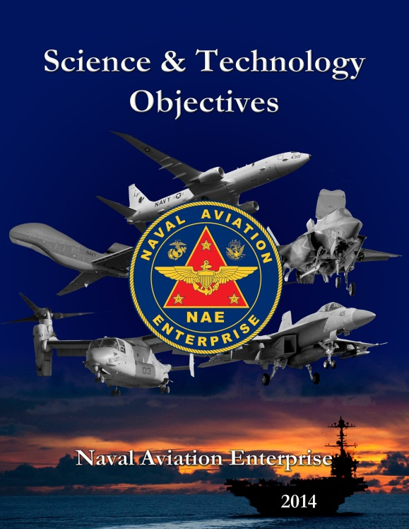
Human Systems Project Alignment
Naval Aviation S&T Objectives
The Science & Technology Objectives (STOs) represent the goals of the NAE S&T program
  Strategy / gaps are identified through the road mapping process
  Road maps provide the ‘plan’ to mature / transition needed technologies to current and future stakeholder needs
  Identifies gaps / thrust areas and the needed technologies
10 Capability Gaps supported by 33 NAE S&T Objectives
  Incorporates lessons learned through STO Road mapping exercises
  Emphasizes need for sustainment, readiness and reduced total ownership cost (TOC)
  Information Dominance replaced C4ISR gaps to align with N2/N6 thrust areas of Assured Command and Control (C2), Battlespace Awareness, and Integrated Fires. STOs are aligned from CNO’s objectives through:
    OSD Joint Capability Areas
    ONR Focus Areas
    Marine Corps Aviation S&T Objectives

Slide 4
Naval Aviation S&T Objectives
NWP = Naval Warfighter Protection, serves as the centering function for Human Performance Research
FP STO-1: Platform Survivability
FP STO-2: Mine and IED Detection and Neutralization
FP STO-3: Electronic Protection
FP STO-4: Surface Torpedo Detection and Neutralization
SUW STO-1: Maritime Surveillance and Interdiction
USW STO-1: Environmental Sensing, Assimilation and Tactical Decision Aids
USW STO-2: Wide Area Search and Detection
USW STO-3: Precision Localization /Identification / Attack
TAMD STO-1: Anti-Air Warfare Performance
TAMD STO-2: Airborne Missile Defense
STK STO-1: Responsive Engagement
STK STO-2: Engagement of Non-Time Critical Targets
STK STO-3: Collaborative Unmanned Strike
STK STO-4: Airborne Electronic Attack
ILS STO-1: Enhanced Logistical Support of Joint Assets
ILS STO-2: Improved Diagnostic and Maintenance Capability
ID STO-1: Command and Control
ID STO-2: Communications and Networks
ID STO-3: Navigation and Geo-location
ID STO-4: Computing, Processing and Architectures
ID STO-5: Cyber Defense, Information Assurance and Network Protection
ID STO-6: Intelligence, Surveillance, Reconnaissance and Targeting
EPE STO-1: Enterprise Enablers
EPE STO-2: Fixed Wing Platform Enablers
EPE STO-3: Vertical Lift Platform Enablers
EPE STO-4: Weapon Enablers
EPE STO-5: Energy Conservation, Flexibility and Security
EPE STO-6: Aircraft/Ship Integration
SSAA STO-1: System Safety and Availability
SSAA STO-2: Total Ownership Cost
NWP STO-1: Training and Education
NWP STO-2: Human Systems Design and Decision Support
NWP STO-3: Warfighter Health, Survivability
and Protection

Slide 5
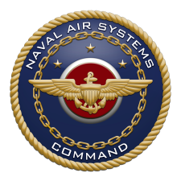
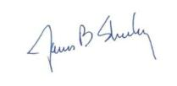
Core Capabilities
Core Capabilities: Are a summary of the current and future research, skill sets/expertise, and critical infrastructure by area resident within NAVAIR. Essential in identifying and directing investments…to support research capabilities over the near, mid and far term based on challenges and / or emerging technology trends
NAVAIR Future Studies:
Core Capabilities Document
Supporting Chapters for:
  Cyber
  Air Vehicle Engineering
  Propulsion and Power
  Avionics
  Human Systems
  Weapons and Energetics
  Aircraft Launch and Recovery
  Equipment (ALRE) & Support
  Equipment (SE)
  Rapid Engineering & Integration
  Warfare Analysis
  Integrated Systems Evaluation,
  Experimentation, and Test
  National Ranges
  Threat/Target Systems
  Integrated Battlespace Simulation and Test
Human Systems Engineering, Integration & Acquisition
Optimized Human Performance & Decision Support
Advanced Training Systems Technology
Human Systems Analysis Design & Evaluation
Warfighter Protection, Performance & Survivability
James B. Sheehy, Ph.D.
Asks the questions: Do we have the capabilities required to conduct near, mid & far term research; the necessary skill sets; and required infrastructure…to develop the technologies that deliver future warfighting capabilities?

Slide 6

Human Systems Research Areas
STOs + Core Capabilities Helps Define Research Initiatives / Projects
NAE Science & Technology Objectives Represent future mission capability needs
10 Capability Gaps supported by 33 NAE S&T Objectives (STOs)
Top down developed by NAE stakeholders (the Fleet, OPNAV, NAVAIR PEOs, PEO Carriers, Marine Corps HQ, ONR)
Alignment ensures NAWCAD is developing relevant technologies to address capability needs/gaps
When Combined identifies key
technology thrust areas
NAVAIR Future Studies:
Core Capabilities Document
NAVAIR Future Studies Core Capabilities Represent the current and future S&T workforce capability needs
S&T skills, expertise and research infrastructure critical to supporting current and future research capabilities
Bottom up drivers from NAWCAD and NAWCWD command S&T leads and division directors
James B. Sheehy, Ph.D.
Alignment ensures NAWCAD maintains a workforce & infrastructure capable of conducting research and development of sophisticated and increasing complex technologies / capabilities

Slide 7
Human Performance, Protection and Sustainment
The Human is a Foundational Element Critical to Technology Thrust Areas
Sustainment
Goal: Sustain warfighters at their peak effectiveness and
performance under all warfighting conditions.
Rationale: Warfighting, People, and Readiness are
the Air Boss’ Priorities to meet the Mission / Vision
to Man, Train and Equip deployable, combat ready
Naval Aviation forces that win in combat.
The Human is a foundational element critical to
Mission / Vision and each of these priorities. It is
essential to recognize that the successful transition of
current and future technologies depends on how humans
perceive, interact with, and use them.
The overarching goals are to:
  Develop predictive models of cognitive performance, physical performance, and injury mechanisms that provide objective metrics for protection, workload, and performance
  Apply new and different approaches to the assessment of training needs, safety, protection, and resilience of individuals and teams
Live-Virtual-Constructive (LVC)
Automation & Autonomy
NAWCAD Technology Thrust Areas
Transformational Air Vehicle & Propulsion Concepts
Electromagnetic Spectrum Technologies & Advanced Sensors
Game Changing Materials

Slide 8
Human Performance, Protection and Sustainment
The Human is a Foundational Element Critical to All Technology Thrust Areas
Each main area is supported by research in a number of critical subareas
Performance:
  Multi-sensory displays
  Advanced interfaces
  Collaborative support, information analysis, and effective interfaces
  Human performance in detecting, identifying, prioritizing, and managing cybersecurity threats
  Methods to support effective human-autonomy teaming
Protection / Sustainment:
  Advanced cost-effective smart materials:
  Computational modeling: predict risk of injury and chronic pain based on human responses Digital human, scanning, and 3D modeling:
  Active materials and digital electronic controls to replace existing pneumatic pressure garments to optimize ejection and crashworthy systems for use in/support of fixed and rotary wing platforms
Training:
  On-demand training strategies and media
  Adaptive training systems
  Technologies and methods for conducting large scale distributed mission training exercises
  Methods for training individual and team performance in detecting, identifying, prioritizing, and managing threats to cybersecurity;
  Training technologies to support individual, team, and team of teams training for effective human-autonomy teaming skills
  Individual, team, and team of teams training effectiveness through human performance measurement and evaluation of impacts on organizational and mission effectiveness.

Slide 9
Aeromedical Top-Ten List
Characterize cockpit breathing environment effects on aircrew physiology and cognition (including gas mix, pressure oscillations, breathing resistance, hypobaria-induced hypocapnia, atelectasis, LSS / environmental contamination, etc.) (CNAF Physiologic Monitor)
Establish Specifications for cockpit pressure fluctuation limits (CNAF Physiologic Monitor)
Hydration, de-hydration, and nutrition pre-flight recommendations (CNAF Physiologic Monitor)
Define Head Supported Mass Criteria to minimize impact on neck and lower spine pain and injury (CNAF Injury Mitigation)
Musculoskeletal Injury Behavioral Guidance and Exercise to institute an Aircrew Conditioning Program (e.g., Professional Athlete model) (CNAF Injury Mitigation)
Seat Endurance Improvements to reduce vibration and provide better lumbar support. Improved Vibro-acoustic protection for pilot, aircrew, maintainer, and ground personnel. (CNAF Hearing)
Situational Awareness Hearing (i.e., filter out high noise without losing the ability to communicate in the air and/or on the deck). At-ear Dosimetry in each of the aircraft environments (inside and outside the aircraft) (CNAF Hearing)
Vision protection and performance with laser threats
Spatial Disorientation mitigation (High Resolution Digital Goggle)
Address waste relief policies and appropriate engineering specs for male and female aircrew
NAVAIR Human Systems Department, NAMRU-D, and the AeroMedical Action Team (AMAT) compiled Aeromedical Top-Ten. Priority dictated by alignment to the Naval Air Force's (CNAF) POM-21 TYCOM Priority List.

Slide 10
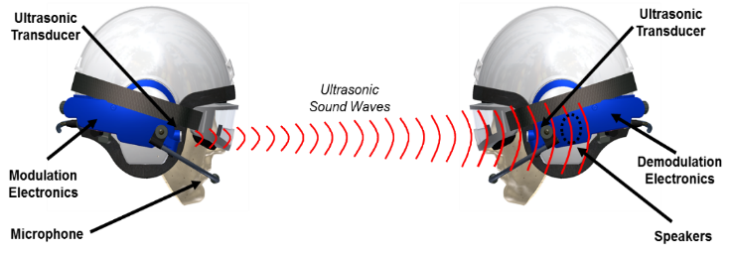
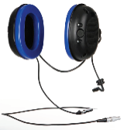
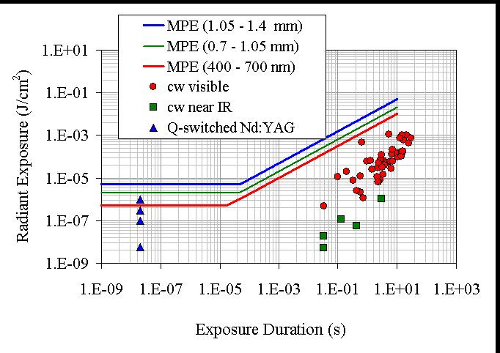
Critical Research Areas
  NAVAIR has a documented, fleet endorsed need and ability to conduct the necessary research to develop & transition products in the following areas:
Hearing/Communications
    Ultrasonic wireless communications
    Wire-free communications earplugs
    In-ear/on-person noise exposure dosimetry
Musculoskeletal Injury Mitigation Design Criteria
    Back and Neck injury metrics & modeling
Agile (Reactive) Laser Protection
    Automatic tinting display visor
Laser Event Recorder
Digital sensors and displays
    See-through display technology
    development
Sources of potential funding include Section 219 - NAVAL Innovative Science and Engineering (NISE), Future Naval Capabilities, & SBIR

Slide 11
2009 Duncan Hunter Defense Authorization Act
Section 219: NAVAL Innovative Science & Engineering (NISE)
Mechanism to Provide Funds to Defense Laboratories for Research and Development of Technologies for Military Missions
The Secretary of Defense, in consultation with the Secretaries of the military departments, shall establish mechanisms under which the executive director of a defense laboratory may use an amount of funds equal to, but not more than three percent of all funds available :
Fund innovative basic and applied research conducted at the defense laboratory that supports military missions
Fund programs to support the transition of technologies developed by the defense laboratory into operational use
Fund workforce development that improves the capacity of the defense laboratory to recruit and retain personnel with needed scientific and engineering expertise
Fund the revitalization and recapitalization of the laboratory (limited to no more than 4M).
Limitations in use:
Can not be used to fund service contracts or CSS employees
Must stay within the warfare center where generated / collected - cannot be sent to other services
Can not substitute or increase funding for tasks specifically limited by Congress or that are already funded by other sources
Can not fund projects that require additional funds to achieve established technical objectives
Can not be reallocated for other purposes by any command levels intervening between the DoD component head and performing laboratory or be tasked to perform specific work
Can not be used to make up deficiencies for other programs
Can not be used to fund general purpose capital expenditures, with exception of equipment required for a project not readily available from laboratory inventory
** Critical source of Discretionary In-House Funding

Slide 12
Human Performance Basic and Applied Research
Sub Initiative | Project Title: Sec 219 NISE Basic & Applied Research
Cognitive Performance | Virtual Reality for Training: Examining the Benefits of Haptic Feedback and Natural Gestures on Procedural and Conceptual Tasks
Protection | Improved Inflatable Body and Head Restraint System (I-IBAHRS)
Protection | Finite Element Analysis for Human Body Simulations
Training | Validation of Speech Transmission Index Public Address (STIPA) for Aircraft Communications
Cognitive Performance | Extended Field of View (FOV) Video Aviation Training Aids
Protection | Custom Earplug Variation and Earplug Fit Assessment Tool
Cognitive Performance | Investigating the effects of shipboard motion on users of virtual reality (VR) systems
Physical Performance | Investigation of Simulator Training Fidelity for Pilot Carrier Qualification Using Precision Landing Modes
Cognitive Performance | Investigating the effect of hypoxia on cognitive workload and brain activity as measured by EEG
Protection | Evaluation of Head/Neck Protection Technologies for Integration into the NACES Seat
Protection | Four-Point Pilot Restraint Pretensioner
Cognitive Performance | Cognitive Recovery Time After Hypoxia Exposure
Cognitive Performance | Integrated Warfighting Capabilities (IWC) Fidelity Investigation

Slide 13
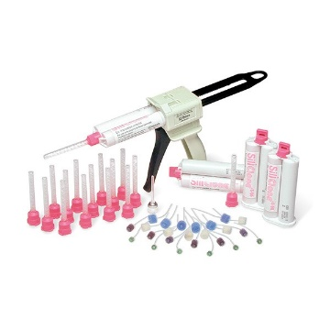
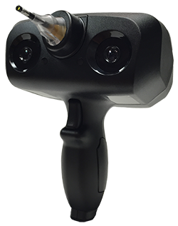
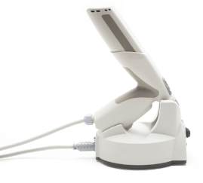
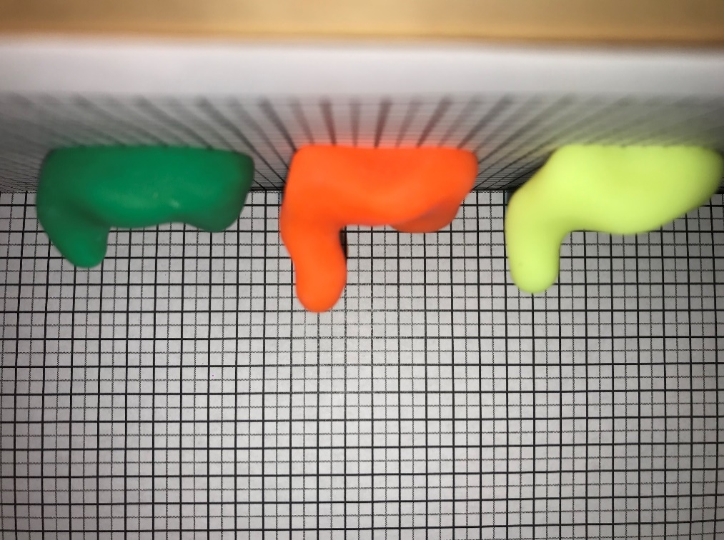
Custom Earplug Variation and Earplugs
Fit Assessment Tool
Objective:
Complete comparisons that began under previous effort between physical impressions and direct digital ear scanning to support the transition of the digital ear scanning methodology.
TRL:
Current: 6 Level at Completion: 7
Achievements:
Purchased Lantos Aura3D digital ear scanner and FitCheck Personal Attenuation Rating (PAR) measurement system
Digitally scanned and obtained two sets of physical impressions for 30 subjects
All physical impressions digitized via 3D scanning
Ordered five pairs of earplugs from each ear canal geometry source
61/90 PAR evaluations complete
Path Forward:
Complete PAR evaluations (FY19)
Create overlays highlighting differences between impressions and digital scans (FY19)
Conduct REAT (Real Ear Attenuation at Threshold) evaluation on a subset of the earplugs (FY19)
Report results (FY19)

Slide 14
Human Performance Technology Transition
Sub Initiative | Section 219 NISE Technology Transition
Protection | Evaluation of New Microphone Technology
Physical Performance | Transition of an End User Automated Performance Measurement Tool
Protection | Aircraft Maintainer Exoskeleton for Equipment Repair
Training | Transition of Crew Role-player Enabled by Automated Technologies to Maritime Patrol Training
Cognitive Performance | Sierra Virtual Reality Helmet Display Targeting System (HDTS) Trainer
Training | Augmented Training for Experiential Learning For Landing Signal Officers
Protection | Aircraft Seat Belt Tensioner

Slide 15
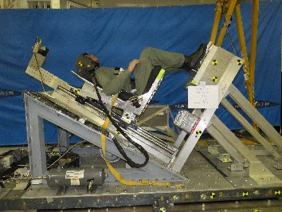
Four-Point Pilot Restraint Pretensioner
Operational Need/Objective:
Investigate whether a four-point pilot restraint pretensioner can reduce the crash injury rate in comparison to currently fielded systems.
The project will deliver a prototype design that has been demonstrated in a laboratory environment through testing and simulation.
Proposed Solution/Technology:
Potential for pyrotechnically driven device that would centrally attach to seating system and pretension restraint.
System performance will be evaluated on Horizontal Accelerator
NAWCAD Impacts/Benefits:
System could potentially improve crash safety and expand cushion design trade space (potential aircrew endurance improvements)
Accomplishments/Outcomes/Potential:
Initial testing was conducted in late FY18
Initial testing promising:
  ~20% reduction in Head Acceleration
  ~40% reduction in Lumbar Load
  ~35% reduction in Chest Acceleration
  ~40% reduction in Neck Injury Criteria
Remaining Tasks/Challenges:
Design and prototyping of a tunable system for optimization purposes
Development of a CAD-driven prototype, designed using data collected in FY18, FY19
Transition Sponsor: N/A
Current TRL: 4
Key Performers / Teams:
  Location of work: NAS Patuxent River
  PI: Brandon Hall, AIR-4.6.6.3, 301-342-3988
  Assoc PI: Brian Harvey, AIR-4.6.6.3, 301-342-8447
  Collaborators: NSWC Indian Head

Slide 16
Human Performance Workforce Development (WFD) – Strategic Growth
Sub Initiative | Project Title: Sec 19 NISE WFD - SG
Protection | Microphone In Real Ear (MIRE) Capability
Biomedical | Strategic Development of Near Eye Display Performance Metrics for Naval Aviation Training Applications
Physical Performance | Automation/Upgrade of the Auditory Performance Laboratory Modified Rhyme Test Capability
Injury Mechanisms | Portable Human Vibration Measurements
Training | Simulation Standards for Interoperability of Human Performance & Debrief Data in Training
Biomedical | Further Development of the Aircrew Accommodation Lab Digital Human Modeling (DHM) Capabilities
Protection | Active Noise Reduction Hearing Protection Device Assessment Method with Narrowband Noise
Training | Next Generation Training Systems Development for Manned and Unmanned Concepts
Protection | 3D Printing of Custom Earplugs

Slide 17
3D Printing of Custom Earplugs
Objective:
Create the new capability to 3-D print custom molded earplugs at Navy sites. This effort addresses the need to provide more effective and easier to use hearing protection to warfighters in extreme noise environments.
TRL:
Current: 3 Level at Completion: 4
Achievements:
Deep insert, canal only prototypes printed
Full concha earplugs printed with varied print resolution and varied digital scan modifications prior to earplug print
Procurement of EnvisionTec 3D printer
Insertion loss measurements for prototypes created from EnvisionTec printer and printed by Carbon3D
  Produced proof-of-concept CEP tip
Path Forward:
Conduct additional insertion loss testing (FY19)
Consult materials engineer to verify suitability of materials used (FY19)
Conduct REAT testing on printed earplugs (FY19)
Develop proposal for logistics of fielding a 3D printing system (FY19)

Slide 18
Incapacitation Prediction in Readiness Domains: an Integrated Computational Tool
(I-PREDICT)
Operational Problem: Warfighter readiness and survivability are compromised by injuries from violent events during training and operations, excessive loading at high speeds, and non-optimized platform designs. Ability to mitigate injury risks, plan medical support requirements, improve platform safety and set operational exposure limits are compromised by antiquated and costly design and test methodologies that use non-biofidelic approaches (e.g., manikin and clay surrogates) that limit agility and adaptability to evolving threats. A human digital twin will help reduce injuries, increase mobility, reduce design cost, and speed equipment and platform development
Demand Signals: (1) PMA 202 Aircrew Systems Master Plan and 2019 S&T gaps: whole body injury prediction modeling (i.e., I-PREDICT) need for head and spine protection, crash survivability and egress, chronic musculoskeletal pain; (2) Marine Expeditionary Force S&T and Experimentation Priorities: lighter armor/PPE; (3) 2018 NDAA, create human physics-based survivability analysis models; (4) Close Combat Lethality Task Force- increase survivability and mobility
Requirements: Joint Force Health Protection Capability Gaps: Enhance ability to withstand trauma, confirm and characterize health impact of threats. Navy Expeditionary Health Services Support Gap 60 (Insufficient ability to protect, mitigate, treat the effects of blast, impact injuries in maritime domain); Military Operational Medicine CBA Study Draft Report for DASD[HRP&O](59. lack of understanding in how mechanical forces are linked to biological and physiological responses)
Proposed FY21 Future Naval Capability (FNC)

Slide 19
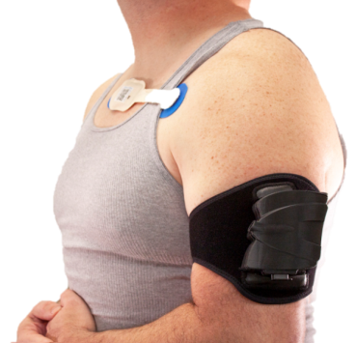
Holistic Modular Aircrew Physiologic Status (HMAPS) Monitoring System
Rapid Innovation Fund (RIF) Defense Innovation Unit (DAU)
Bluetooth ECG Patch
Bluetooth Ear Clip
•
Isansys
•
OEM Pulse Ox
•
Single use disposable
Hardware
•
LED
•
Temperature Sensor
•
Single User Switch
•
LEDs
Bluetooth LE
Bluetooth LE
HMAPS Arm Unit
Measures:
Heart/pulse rate
Multiple SpO₂ from arm and a plug-in for finger or a wireless ear piece
Skin Temperature
Respiration Rate derived from the ECG and pleth wave
Incorporates environmental sensors
  Ambient VOC; Altitude; Dynamic Pressure; G; Temp / Humidity
Derives additional vitals, such as Pulse Wave Transit Time and Heart Rate Complexity
Signal Quality Index: Reject poor signals
Connects up to 20 BLE devices
•
ECG Hardware
•
Pulse Ox Hardware
•
Skin Temperature Sensor
•
Environmental Sensor Suite
Real
-
Size: Arm unit (L x W x D): 4.5” x 3.25” x 1.5”
Weight of Arm Unit with Battery: 5.4 oz
Data storage: 100 hours, Battery Life: 8 hrs
•
Time Clock
•
Single User Button with LEDs
•
Micro USB
USB Cable/Wi
-
Fi
PC
Arm unit viewer (Wi
-
•
Fi)
Subject specific inputs (Wi
•
Fi)
-
•
Data download (USB)
•
Firmware Update (USB)
FDA cleared Athena Device Management Suite (ADMS) displays and downloads data –
PC, iOS, Android

Slide 20
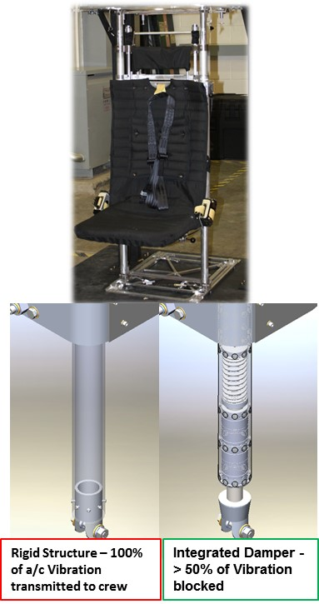
Vibration Isolation Damper System for the MH-60S Gunner Seat
Rapid Innovation Fund
Project Objectives:
Decrease the severity and incidence of back pain
Decrease vibration dosage reaching seated crew
Increase crew’s mission endurance and career longevity
Project Scope:
Refine damper performance
Conduct damper service life testing
Environmental susceptibility testing (e.g., salt fog intrusion)
Crash load performance testing.
Flight demonstration testing
Major Activities / Milestones:
Damper performance assessments (Month 4)
System life characterization & refinement (Month 6)
Enviro. and Crash load Qualification testing (Month 9)
Flight testing (Month 15)
Deliverables / Measures of Success:
Fully qualified seat-integrated vibration isolation system
Flight test data demonstrating >50% reduction of a/c vibration transmitted into seated crew members.
Isolation system increases time that crew can conduct missions without reaching vibration dosage exposure limits (per Safety Standard ISO 2631-1)

Slide 21
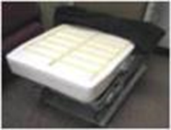
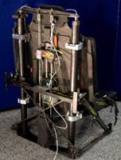
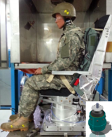
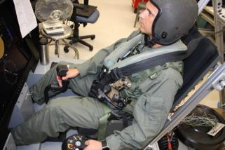
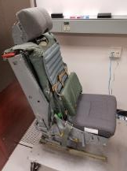
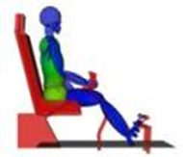

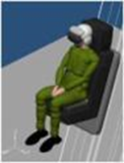
Mission Endurance Enhancements - (Seats)
Sec 219 & BA4 Funding
Determine factors contributing to neck/back pain – behavior, equipment, loading:
Aircrew Endurance
Cushions
Addressing Flight Equipment Mass
Helmet
Vibration Isolation
Technologies to reduce loading
Vibration Mitigating Seats
Active Seat Cushion – Fixed-Wing Non-Ejection/Rotary-Wing Crashworthy
Lower Back Support Endurance and Crashworthiness Evaluation
Modeling to predict acute and chronic pain onset & severity
Prediction and Mitigation of Back Pain in Military Pilots and Vehicle Occupants
Active vibration attenuation
Helo-Hunch
Lumbar support
Computational modeling

Slide 22
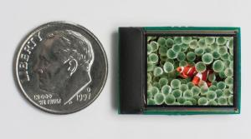
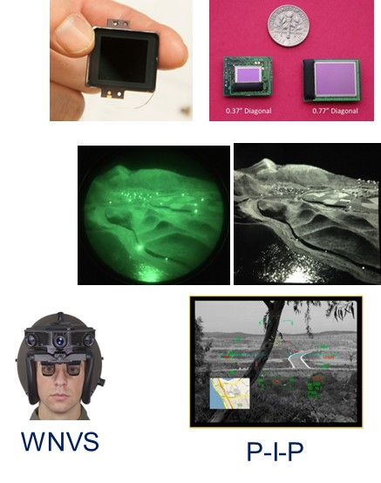
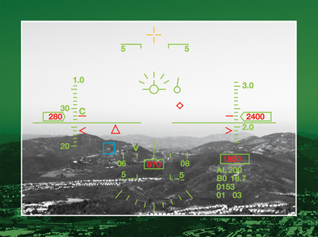
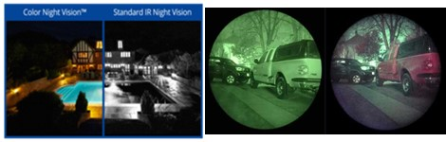
High Resolution Digital Night Vision
(BA4 Funding)
Develop digital technologies to improve resolution, add color, with enhanced display information
Reconfigurable High Brightness Organic Light Emitting Diode (OLED)
ISIE19 Development: USN and USA co-developing next gen Digital Night Vision Sensor (ISIE19 EBAPS) on schedule.
See-Through Display technology
Color Night Vision technology
Wide Field of View Night Vision System (WNVS) Upgrade:
Upgrade WNVS prototype to improve night vision performance and enhance overall system performance for future USN/USMC demonstrations.
Upgrade sensors and displays to support latest technology advancements.
Address concerns/issues seen with extended FOV, partial overlap, sensor stitching ,and see-through optics.
Next Generation Digital Night Vison Demonstrator: Build and flight test an advanced binocular vision system using latest NV sensors, displays and processing technologies.
Improve facility test and analyses
  Digital Night Vision System Test Capability Development
  Night Lab Development
ISIE19
OLED
DNVG Overlay

Slide 23
Tech Transitions/Accomplishments
TT: Transition of Crew Role-player Enabled by Automated Technology Enhancements (CREATE) to Maritime Patrol Training
  Identified user interface elements & transparency levels to inform design concepts for development and analysis of instructional interfaces and functionality (JAN-JUL 19)
  Develop & validate set of automated communication performance measures (MAR-AUG 19)
  Conduct automated speech recognition engineering data collection to baseline system performance and reliability, and identify areas for system maturation and refinement (JUN-SEP 19)
  Develop research protocol to evaluate baseline & future workload and community trust in automated technologies; initial data collection survey based with identification of opportunities for controlled research studies (APR-SEP 19)
TT: Examination of Increased Capability Crash Recording Technologies in the Naval Aviation Mishap Application
  Additional COTS equipment tested in FY18
  Additional equipment planned for procurement in FY19. Improved system will be in master/satellite architecture.
  Transition: Performance Specification for Crash Recorder System
WFD-SG 3d Printing of Custom Earplugs
  Provided sample earplugs and an expedited transition plan and costs to Sec Guerts
WFD-SG: Simulation Standards for Interoperability of Human Performance & Debrief Data in Training
  Develop paper and presentation on Human Performance Markup Language (HPML) standard and necessary policy considerations to ensure continued human performance assessment validity with increased accessibility
  Develop technical report that summarizes status of relevant standards and identifies impacts to Navy science, technology, R&D, and/or acquisition (JUL-AUG 19)
  Evaluate HPML’s support for communication performance measures based on current structure and develop presentation/publication for future Simulation Interoperability Standards Organization (SISO) meeting (MAY-JUL 19)

Slide 24
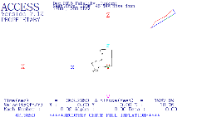
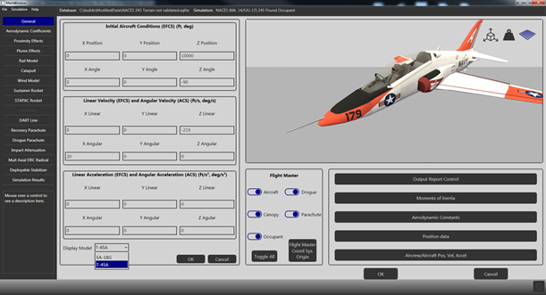
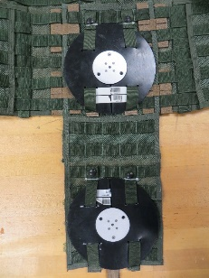
Tech Transitions/Accomplishments
BAR: Finite Element Analysis for Human Body Simulations
  Created 3D Models (90%)- Created CAD model of helmet drop tower assembly, HGU-68/P helmet, NAVAIR Neck, NRL Head, Symmetric NRL Head/NAVAIR Neck
  Defined Material Models (70%)- Completed Primary (shell, EA liner, earcup) quasi-static mechanical tests and high-rate Split Hopkinson Pressure Bar EA liner tests.
  Meshed Models (60%)- Meshed HGU-68/P helmet/DOT headform & droptower assembly (100%), Symmetric NRL Head/NAVAIR Neck (10%)
BAR: Four-Point Pilot Restraint Pretensioner
  Initial testing demonstrated:
    ~20% reduction in Head Acceleration
    ~40% reduction in Lumbar Load
    ~35% reduction in Chest Acceleration
    ~40% reduction in Neck Injury Criteria
RR: Advanced Crew Capsule Escape System
Simulation (ACCESS) Software Modernization
& Enhancement
  Prototype is working within NMCI framework
  Pre-processor GUI and visualization being refined
Portable Human Vibration Measurements [219WFD-SG-18-007]
  Vest mounted system fabricated using material already available to NAVAIR
  Key Metrics/Milestones: Laboratory testing/evaluation, & Flight Test
  Human Subject testing scheduled on AFRL’s man rated platform
From this…
…to this!

Slide 25
Human Performance - Summary
Sub Initiatives:
Biomedical
Cognitive Performance
Injury Mechanisms
Performance
Protection
Training
Human Performance established as a Strategic Initiative
Current projects making significant progress in
one or more of Human Performance’s 4 main areas
  Protection
  Performance
  Sustainment
  Training
Projects supported throughout development lifecycle by different funding sources to reach critical end state. For example:
    BAR: 3D Printing of Custom Earplugs
    WFD: Custom Earplug Variation & Fit
    WFD: Active Noise Reduction Hearing Protection
    RR: Real Ear Attenuation
    Or
    BAR: Finite Element Analysis for Human Body
    BAR: Evaluation of Head/Neck Protection
    BAR: Four Point Pilot Restrainer
    TT: Aircraft Seatbelt Tensioner
All S&T – RDT&E research is linked from National Defense Strategy to CNO’s priorities to PMA 202’s ACS Roadmaps
  Each effort has a clearly defined, traceable / defensible need
Develop, test, and manufacture protection for a high noise (< 65 dB) environment
Protection in a high G environment

