Slide 1
Aircrew Systems PMA202 Overview
24 July 2019
Aircrew Systems Industry Partners
CAPT Tom Heck, PMA-202
Warfighter focused
& Cost Conscious
NAVAIR Public Release 2016-820 Distribution Statement A –
“Approved for public release; distribution is unlimited”

Slide 2
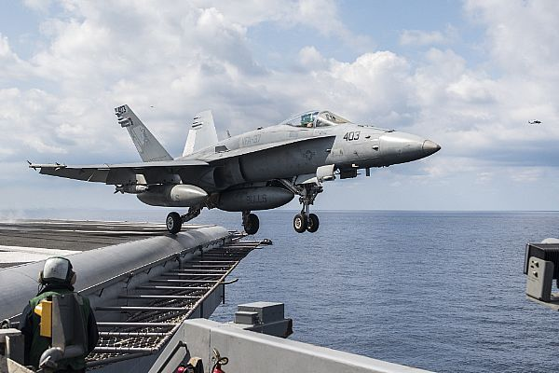
PMA202 Mission
Deliver aircrew and aviation maintainer systems in order to optimize Naval Aviation’s combat effectiveness

Slide 3
PMA-202’s Portfolio
Personal Protection & Performance
Anti-exposure systems
Boots, gloves, socks, undergarments
Communication headset components
Flight Clothing: suits & jackets
Flight Deck & Maintainer Cranials
Helmets, Hearing Protection systems
Personnel heating & cooling systems
Visual Situational Awareness
Enhanced Visual Acuity
Night Vision Cueing & Display
Night Vision Goggles
Chem Bio Defense: Protection & Perseverance
Detection & Decontamination systems
Respirators
Skin exposure protection clothing
Combat Survivability& Perseverance
Anti-G-Force protection suits
Bladder Relief systems
Body Armor
High endurance seat cushions
Hydration sustainment systems
Laser Eye Protection & FOD glasses
Smoke masks
Escape, Egress, Evasion & Recovery
Crashworthy seats & Restraint systems
Escape systems – ejection seats
Parachutes
Survival radios, signaling devices
Survival rafts, Life Preservers
Survival vests, Survival kit items
Underwater breathing apparatus
Physiological Episode Protection
Oxygen generation systems, masks, filters, monitors, emergency bottles
1070 In-Service Products, 10 active Acquisitions

Slide 4
PMA-202 Organization
Prgm Int Team
Program Manager
CAPT T. Heck
Operations
R. Sullivan
Principal Deputy PM
G. Crewse
Planning / Capability
Headquarters Group
Leads / APMs
Production Integration
D. McLure
Strategic Planning
F. Behrman
CBD Capability Mgr
W. Strang
Program Integration
L. Scott
APMSE
E. Schwartz
PID Lead
M. McLaughlin
RI Fleet Liaison
D. Meyer
APM Test & Eval
J. Hoagland
IT
M. Curley
Executive Admin
C. Armour
Level 1 IPTLs
Class Desk / DAPMSE
LCDR I. Kirschke
Aircraft Devices
D. Church
Vision Systems
B. Schieferdecker
In-Service Support Center
S. Adley
Personnel Protective Equipment
L. Guy
PSM
C. Dixon
EEOS IPTL
R. Burwell
EVA IPTL
C. Stead
ISSC Deputy
CDR S. McCarthy
DHP/THP IPTL
J. Bartnick
Contracts
J. Billig
NACES IPTL
G. Blakely
NVCD IPTL
R. Campbell
AECS FST Lead
K. Bordeaux
F-35 HP IPTL
M. Mackey
Lead BFM
LCDR C. Radke
OBOGS IPTL
C. Beans
Chem Bio FST ISSC
VACANT
LEP IPTL
T. Bean
Cost
S. Hanson
LEGEND
LSS FST Lead
LCDR. Baca
= EOB
Phys Monitor IPTL
J. Wathen
Legal
L. Ohanesian
= NAWC
= MIL
Fleet Maint Liaison
PRC Steingraber
MIST/FAILSAFE
LT V. DeBons
JSAMS/CBD IPTL
VACANT
CM / DM
D. Adams
= CSS
= Non-NAVAIR
PE IPTL
C. Burghardt
NVS FST Lead
T. Hock (NSWC Crane)
JSF
LCDR E. Villalba
Sponsors
OPNAV: N98, LCDR A. Coates
N83, LCDR C. Johnson
HQMC: APW76, CDR J. Mahoney
CNAF: N01H, CAPT Yniguez
CNAL: N817, CDR G. Wright
State of the Art
S. Milburn
AOS FST Lead
S. Nelson
International Programs
R. Carter
Notes:
Here is my team.
If you were to compare this to a standard platform program office you would see how lean we are.
Many of our people are covering multiple products or sectors, and often managing non-classic short turnaround efforts which in many ways are harder in the acquisition world than classic programs.

Slide 5
Fleet Demand Signal
Aircrew Systems Top Issues for POM-22:
  Endurance; Aircrew Back and Neck Injury Mitigation
  Hearing Protection and comms intelligibility
  Enhanced Visual Acuity; Next generation day/night heads up visual Situational Awareness
  Post Egress Passive Signaling and Survival
  Improved Combat Survival Radio
  Aircrew Life Support Systems Deficiencies Corrections

Slide 6
Our Challenges
  Bulk and weight reduction
  Thermal Regulation
  Passive Signaling
  Laser Eye Protection
We need a holistic solution, not optimized individual capabilities

Slide 7
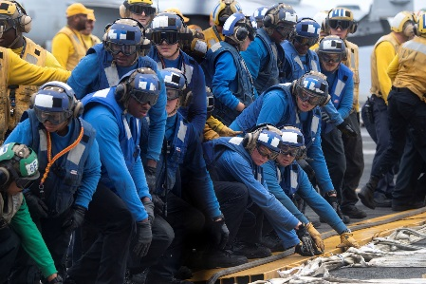
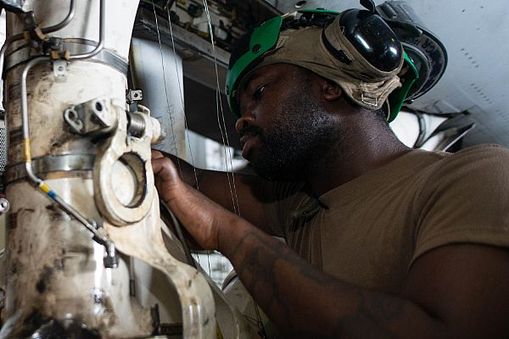
Head Protection
Operational Requirement:
  Fall and impact protection
  Hearing protection
  Clear and intelligible communications on the flight line and flight deck
  Low profile design
Program of Record:
Legacy Cranial – cheap, simple, durable, limited adjustability
Fleet usage issues:
Deficiencies:
  design is > 50 years old
  prohibits inspection of tight spaces
  only provides minimal fall and impact protection
  needs better hearing protection and comms intelligibility
Industry help needed:
Desired attributes:
  smaller profile, more conformal fit
  improved fall and impact protection
  light-weight, durable
  improved thermal characteristics
  improved hearing protection and comms intelligibility
  affordable
Notes:
Cranial deficiencies:
design is > 50 years old
prohibits inspection of tight spaces
only provides minimal fall and impact protection
needs better hearing protection and comms intelligibility
Desired head protection system attributes:
smaller profile, more conformal fit
improved fall and impact protection
light-weight
improved thermal characteristics
improved hearing protection and comms intelligibility

Slide 8
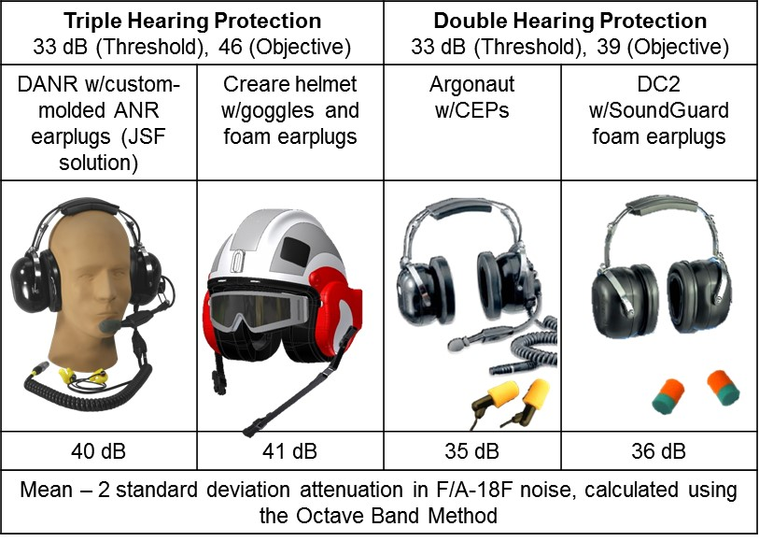
Hearing Protection
& Communications Intelligibility
Operational Requirement:
Protection from temporary and permanent hearing lost
Clear, intelligible voice communications exchange on the flight deck and flight line
  Between headsets operating on coordinated comms channels
  Between personnel standing next to each other not using radio comms
Program of Record:
Double Hearing Protection
Triple Hearing Protection
Fleet usage issues:
Deficiencies:
  Current helmet noise attenuation is inadequate in some environments
  Newer aircraft are notably louder: JSF, E-2D, MV-22, CH-53K
  E-2D personnel are suffering significant hearing threshold shifts after one flight
  Inconsistent custom ear-plug fit with complicated logistics support structure
Industry help needed:
Exploration of attenuation technologies and materials (~20 db improvement)
In-ear dosimeters & micro-components
Platform noise dampening
Desired attributes:
  Comfortable, consistent fit
  Affordable, with practical logistics
Notes:
Hearing protection: Aircrew and flight line personnel continue to be exposed to hazardous noise environments resulting in permanent hearing loss. Missed critical radio/ICS calls can put the aircrew and mission at risk.
Double Hearing Protection program fielded improved protection for maintainers and flight deck personnel.
Triple Hearing Protection will improve noise attenuation for maintainers, flight deck personnel and Aircrew.
Current shortfalls:
Newer aircraft are notably louder: JSF, E-2D, MV-22, CH-53K
Current helmet and noise attenuation technology is inadequate in some environments.
E-2D personnel are suffering significant hearing threshold shifts after one flight.
Requires exploration of alternate technologies and materials.
Industry inputs and assistance are welcome!!

Slide 9
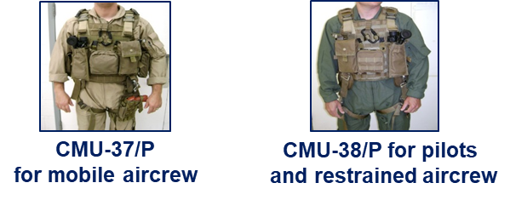
Survival Vest, Flotation & Armor
Operational Requirement:
  Mounting platform for Aircrew Life Support Equipment (ALSE)
  Flotation system, armor protection, signaling and survival equipment
  Mobility that enables performance of mission
  Allows crew to hydrate and urinate with minimum disruption on extended missions
  Load bearing during falls, crashes, rescue
Program of Record:
Legacy vest (CMU-33 & PRU-70)
Replacement vest (CMU-37 & CMU-38):
Fleet usage issues:
Deficiencies:
  Restricts mobility, causes fatigue and interferes with effective egress
  Interferes with H-1 flight control operation
  Chafes against helmet
  Overheats and stresses Aircrew
  Sub-optimal flotation orientation
  Cannot jettison armor protection
Industry help needed:
Exploration of technologies, materials and equipment configurations
  Lighter, durable, breathable material
  Neutrally buoyant, flexible body armor
  Simple reconfigurability, size adjustment
  Reduced snag hazard
  Practical, comfortable hoist harness
  Compatibility with Chem Bio protection
  Superior flotation orientation
Notes:
Legacy vest (CMU-33 & PRU-70): Fleet users noted these solutions were heavy, bulky and did not incorporate an integrated rescue hoist harness configuration.
Replacement vest (“Aircrew Endurance” CMU-37 & CMU-38): Designed to address noted deficiencies with legacy vests, but fell short of Fleet’s expectations.
Demonstrated improved fall protection, weight distribution, fatigue reduction, buoyancy and fragmentation protection (compared to PRU-70 in the same loaded configuration). Also incorporated an integrated rescue hoist harness and load distributing gunner’s harness connection.
Still does not meet Fleet Aircrew needs:
Still considered too heavy and bulky. Restricts mobility, causes fatigue.
Interferes with H-1 flight control movements.
Additional desired attributes: improved flotation (buoyancy & orientation), jettisonable body armor, facilitation of easy cabin egress, compatibility with chem bio ensemble.

Slide 10

Thermal Regulation
Operational Requirement:
  Regulation of Aircrew and Maintainer body temperature during operations in hot and cold environments
  Prevent over-exposure
  Minimize fatigue
  Maintain mobility and dexterity to perform required flight and maintenance functions
Program of Record:
Qualified Multi-Climate Protection clothing ensembles
Qualified cooling vests for H-53 crews
Continuous exploration/evaluation of COTS and Non-Developmental passive and active thermal regulation products
Fleet usage issues:
Deficiencies:
  Increased body temperature has led to reduced mission endurance
  Reduced body temperature has led to difficulty in performing mission sets
Industry help needed:
Exploration of technologies and materials
Durable, light-weight, breathable yet affordable materials
Portable, compact, non-restrictive, light-weight thermal regulation systems that last throughout extended missions and utilize mainstream power sources

Slide 11
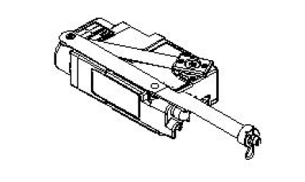
Survivor Signaling
Operational Requirement:
Downed Aircrew must be recovered quickly before overexposure or capture.
Over the Horizon distress & location broadcast
Encrypted Low Probability of Detection and Low Probability of Intercept signal (LPD/LPI)
Line of Sight survivor to rescue platform voice communications
Passive capability for incapacitated survivor – automatic g-force/ejection/water activation that continues when the survivor is in the water
Program of Record:
URT-140
Non-combat survival radio
Combat Survivor Evader Locator radio
Fleet usage issues:
Deficiencies:
  Incapacitated aircrew cannot transmit location.
  Antenna
  Inadequate light signal, sea dye marker
Industry help needed:
Alternative signaling solutions
Desired attributes:
Self-activated: g-force/ejection/water
Accurate OTH distress and geo-location
Auto-activation and continued operation for incapacitated survivor
Can be manually turned on and off
Covert, LPD/LPI
Direct LOS comms to rescue vehicle
Notes:
Laser Eye Protection is another challenging capability area. We have a solidly document requirement and a product that meets specifications, but nobody really wants to wear it. The specs can be uncomfortable under the earcups, or change the color of your view (to the point that some wearers say it degrades their SA); and the step-in visors are so close to the face that they cause condensation that deteriorates visual acuity. So we’ll continue to provide product as directed, and continue to look for improved form fit solutions.

Slide 12
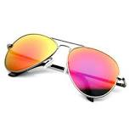
Laser Eye Protection
Operational Requirement:
Naval Aviation Aircrew must be able to continue operations in environments where both visible and invisible friendly and hostile lasers are employed
Friendly sources include range-finders, targeting sensors, night vision environment illuminators
Program of Record:
Started vendor competition. Currently in source selection.
Solution expected to include goggles and step-in visors
Inventory objective = 3500 units.
Fleet usage issues:
Deficiencies:
Aircrew are at risk of eye damage from both friendly and enemy lasers operating in unprotected frequencies
Current systems have fit & transmittance issues that drive aircrew to decide not to wear them
Industry help needed:
Exploration of technologies and materials
Laser usage detection, characterization and event recording
Develop a system solution that can detect and instantly tune, filter or block damaging laser energy
System should integrate effectively with helmet and other Life Supt Equipment

Slide 13
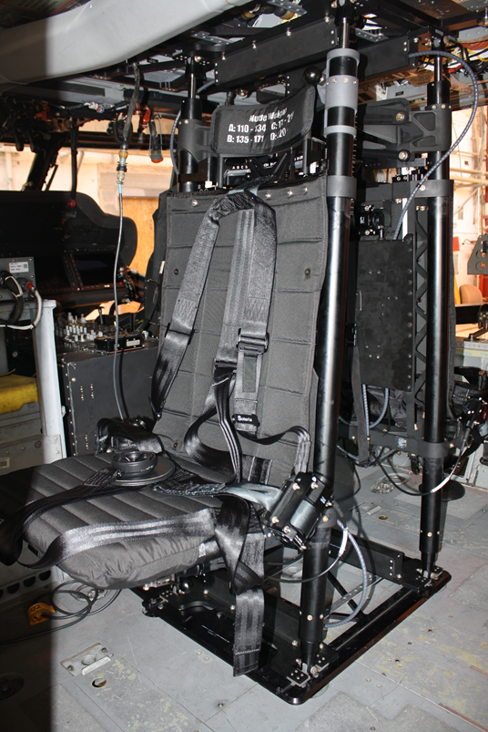
Mission Endurance
Operational Requirement:
  Flight equipment and seating that support Aircrew and Maintainer ability to conduct extended missions
  (Thermal aspects addressed earlier)
  Focus on other aspects – vibrations, seat configurations and components, neck and back load reduction, knee injury avoidance
Program of Record:
MH-60S Gunner Seat Replacement
Fleet usage issues:
Deficiencies:
  Aircrew ensemble is bulky & restrictive
  Seating systems need ergonomic upgrades
Industry help needed:
Exploration of technologies and materials
  Ergonomically optimized seating systems: cushions, lumbar support
  Reduced vibrations: seats, mounts, platform structural dampening/tuning
  Reduced helmet/head system weight and/or improved center of gravity
  Knee protection, cabin mobility

Slide 14
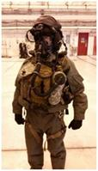
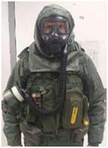
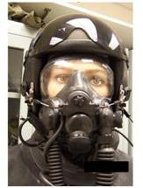
Chem Bio Equipment
Operational Requirement:
Naval Aviation Aircrew must be able to perform extended tactical operations in a Chemical Biological contaminated environment.
Different configurations are required for different platforms and Life Support Equipment interfaces
  Skin protection
  Respiratory protection
  Extended mission endurance
Program of Record:
Navy is currently following Army Joint Program
JSAM Rotary ~ 2018
JSAM Strategic ~ 2018
JSAM Tactical ~ 2020
JSAM Rotary
JSAM Strategic
JSAM Tactical
Fleet usage issues:
Deficiencies:
  Thermal burden
  Mobility restriction – fatiguing
  Incompatibility with other Aircrew Life Supt Sys
Industry help needed:
Improved materials
  Better protection
  Lighter, thinner, more durable
  Thermal regulation – breathable?
  Longer shelf life
Notes:
PMA202 is the Aviation Chem Bio office for Naval Aviation, but we count on the Joint Program Office for most of the major component solutions. If you have never had to put one of these on, feel fortunate. Hopefully none of us will ever have to use one for real, right? But every now and then there are events that make us remember we may need this gear, like the meltdown in Japan or even this year’s chemical warfare attacks in Syria. The gear is complicated, has to fit several different cockpit layouts, is expensive, and does not last forever. The good news is that there are improved Mask products coming out in the next couple years.

Slide 15
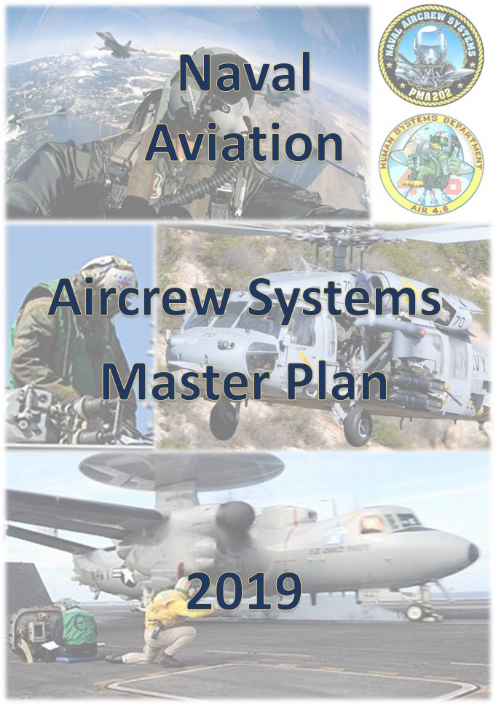
Coordinating the ACS Path Forward
Aircrew Systems Roadmaps and Master Plan
Introduction / Overview
Personnel Protection & Performance Sustainment
Combat Operations Survivability & Perseverance
Physiological Episode Protection
Visual Situational Awareness
Chem Bio Defense Exposure Protection & Perseverance
Ejection, Crash Survivability & Egress; Survival, Evasion & Recovery
Distribution statement D. Distribution authorized to Department of Defense and U.S. DoD contractors only, administrative use or operational, 28Feb2019. Other requests shall be referred to the Assistant Commander for Acquisition (AIR 1.0), PMA-202, Naval Air Systems Command, 47123 Buse Road, Patuxent River, Maryland, 20670. WARNING – This document contains technical data whose export is restricted by the Arms Export Control Act (Title 22, U.S.C., Section 2751 et seq.) or the Export Administration Act of 1979, as amended, Title 50, U.S.C., App. 2401 et. seq. Violation of these export laws are subject to severe criminal penalties. Disseminate in accordance with provisions of OPNAVINST 5510.161.
PMA-202 Overview, 2019 Industry Day Conference, SPR 2019-###
Notes:
We also want you to know that we do have coordinated plans for improving your Aircrew Systems. This is one of them. The rest are included in the backup of this brief, which will be made available to you. It shows what AIR 4.6 is doing to advance technology, what we are doing with our funding to deliver system enhancements or new capabilities, and what we recommend gets addressed in future POM cycles. There are five roadmaps, one for each major Capability Area. We’re close to publishing the Aircrew Systems Master Plan that provides descriptions and details of all the entries on each roadmap.

Slide 16
Coordinating the ACS Path Forward
Bold green font entries represent current baseline states
Black dashed lines with regular black font show funded advanced research & technology development activities.
(Gray dotted lines are unfunded recommended initiatives.)
Solid lines and blue font represent funded capability enhancements
Capability Area Elements - attributes or functionalities
Red dotted lines with italic red font show unfunded recommended capability pursuits
Desired future capability state
PMA-202 Overview, 2019 Industry Day Conference, SPR 2019-###
Notes:
We also want you to know that we do have coordinated plans for improving your Aircrew Systems. This is one of them. The rest are included in the backup of this brief, which will be made available to you. It shows what AIR 4.6 is doing to advance technology, what we are doing with our funding to deliver system enhancements or new capabilities, and what we recommend gets addressed in future POM cycles. There are five roadmaps, one for each major Capability Area. We’re close to publishing the Aircrew Systems Master Plan that provides descriptions and details of all the entries on each roadmap.

Slide 17
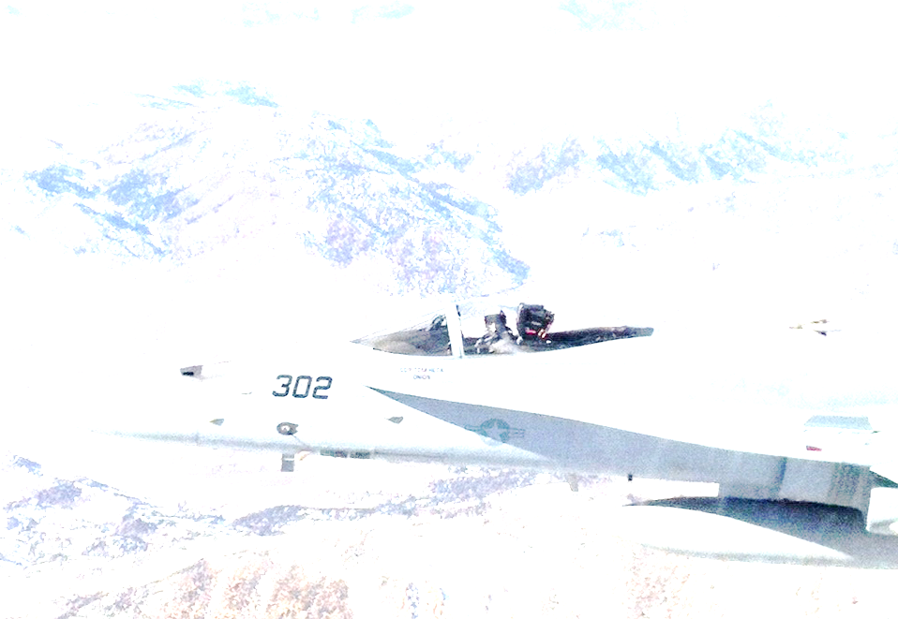
Industry Partner Take-aways
What challenges does PMA202 face?
What solutions could I and my company offer to help and how do they fit into the “system”?
What issues have the best chance of being put forth to the resource sponsor?
Which of those issues have the best chance of getting funded?
Where do I focus my efforts to improve the mission effectiveness of Naval Aviators / Aviation Maintainers and help my company grow?
Side bars are encouraged – now is the time to get input and feedback
We need Industry informed requirements and solutions

Slide 18
PMA202 POCs
Program Manager – (301) 866-5420
Principal Deputy Program Manager – (301) 866-2437
Aircraft Devices – (301) 866-4434
Vision Systems – (301) 866-5424
In-Service Support Center – (301) 866-2424
Personnel Protective Equipment – (301) 866-2443
Strategic Planning – (301) 866-4409
Military Class Desk/Fleet Liaison – (301) 866-4423

Slide 19
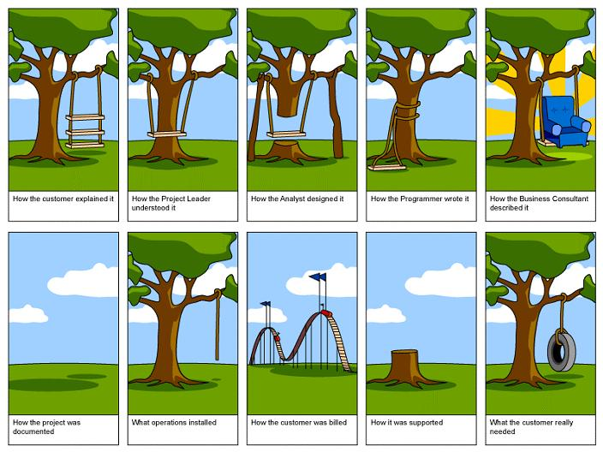
Questions?
You can help save us from ourselves!

Slide 20
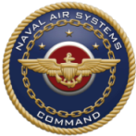
Personnel Protection &
Performance Sustainment
Aircrew Systems
Capability Evolution
Roadmaps 2019
Capability
Elements
Passive clothing layers
Exposure
Protection
Cold weather gloves; Improved Undergarment thermal regulation (b)
Improved
Boot (b)
Cold
weather
boots (c)
Regulated body cooling; Reduced bulk & wicking cold weather protection (a-e); Improved fire
protection (b)
Regulated
body
heating (d)
a. Multi-Climate Protection (MCP)
b. Improved materials - fire protection & durability
c. Cold-weather footwear & extreme foul weather gear
d. Thermoregulatory product exploration
e. Improved materials MCP exploration
Head &
Musculo-skeletal
Protection
Legacy helmets & cranials
Improved flight deck personnel & maintainer head protection (h)
Improved Fixed Wing helmet fit, Helmet Mounted
Device (HMD) stability & maintainability (f-i);
Back and Neck Injury Mitigation Program (h,j,k)
f. E-2D helmet vibration study
g. Whole body injury prediction modeling
h. Helmet/head & neck injury modeling
i. Assessment of lower back disorder influence on motion sickness & cognition
j. Common FW helmet
Optimum Human System Performance,
Protection & Persistence
k. Exoskeleton systems maturation
Hearing
Protection
& Speech
Intelligibility
Passive attenuation products
Improved JSF flight deck
& aviation maintainer
Hearing Protection (DHP)
Improved Passive Hearing Protection (i);
Stereo audio signal
Imp Flt Dk &
Mntnr Hrg
Prot (THP)
ANR for FW Jets
(n,q) Improved
Earcup material (l)
Non-invasive ear canal mapping (m)
Improved flight
deck face-to-face communications (o) Wire-free comms (t) In-ear dosimetry (u)
On-site custom
earplug
provision (n)
ANR for Rotary
Wing (q,r,s)
Improved E-2D Hrg Prot (f,l)
l-1. Improved earcup seal material
l-2. Improved earcup material
m. Non-invasive custom ear canal mapping
n-1. On-site custom earplug manufacturing
n-2. Dual-density earplugs
o-1. Maintainer ultrasonic wireless communications
o-2. Ultrasonic wireless communications producibility
p-1. Ultra Wideband (UWB) Wireless Intercom
p-2. UWB WICS producibility
q. Active Noise Reduction device assessment
r. ANR device evaluation
s. Audio component enhancements
t. Wire-free communications earplugs
u. In-ear/on-person noise exposure dosimetry
FY: 18 19 20 21 22 23 24 25 26 27
Capability
Baseline
Adv Research or
Tech Maturation
Funded
Funded Capability
Enhancement
Unfunded Potential
Capability Development
Joint
Initiative
Unfunded
Distribution statement D. Distribution authorized to Department of Defense and U.S. DoD contractors only, administrative use or operational, 28Feb2019. Other requests shall be referred to the Assistant Commander for
Acquisition (AIR 1.0), PMA-202, Naval Air Systems Command, 47123 Buse Road, Patuxent River, Maryland, 20670. WARNING – This document contains technical data whose export is restricted by the Arms Export Control Act (Title 22, U.S.C., Section 2751 et seq.)
or the Export Administration Act of 1979, as amended, Title 50, U.S.C., App. 2401 et. seq. Violation of these export laws are subject to severe criminal penalties. Disseminate in accordance with provisions of OPNAVINST 5510.161.
20

Slide 21
Combat Operations
Survivability & Perseverance
Aircrew Systems
Capability Evolution
Roadmaps 2019
Capability
Elements
Air Combat
Maneuver
Support
Air bladder pressurized G Suits
a. Improved durability materials
Improved maintainability G Suit (a)
Threat
Defense
Fixed wavelength multi-line Laser Eye Protection (LEP); bulletproof armor
Improved fit & clarity multi-line LEP spectacles (c-e)
Improved LEP step-in & visor (c-g)
b. Soft armor assessment
b-2. Enhanced soft material armor
Lightweight, reduced bulk,
flexible ballistic protection (b,d)
c. Eye protection integrity monitor
d. Ballistic injury risk modeling
e. LEP display compatibility
f. Laser event recorder
g. Reactive LEP
Persistent and Survivable
Dynamic Combat Operations
Extended
Mission
Endurance
Increased endurance seat cushions; lumbar support; bladder relief
Improved MH-60S Gunner Seat (h)
Improved Bladder Relief (i)
Seat vibration induced injury reduction (k,l);
Higher endurance seat cushion with
customized lumbar support (m,n);
Reduced weight & bulk man-mounted
survival equipment (j,k,r)
h. High Endurance Gunner Seat
i. Improved bladder relief
j. Human pain & fatigue modeling
k. Human vibration measurement
l. Airframe vibration mitigation
m-1. Cushion & lumbar improvements
m-2.Custom cushions with lumbar support
o. Neck pain reduction conditioning
n. Aircrew seat endurance
p. Neck injury metrics and modeling
q. Aircrew Conditioning Program (ACP)
r. Maintainer conditioning program
FY: 18 19 20 21 22 23 24 25 26 27
Capability
Baseline
Adv Research or
Tech Maturation
Funded
Funded Capability
Enhancement
Unfunded Potential
Capability Development
Joint
Initiative
Unfunded
Distribution statement D. Distribution authorized to Department of Defense and U.S. DoD contractors only, administrative use or operational, 28Feb2019. Other requests shall be referred to the Assistant Commander for
Acquisition (AIR 1.0), PMA-202, Naval Air Systems Command, 47123 Buse Road, Patuxent River, Maryland, 20670. WARNING – This document contains technical data whose export is restricted by the Arms Export Control Act (Title 22, U.S.C., Section 2751 et seq.)
or the Export Administration Act of 1979, as amended, Title 50, U.S.C., App. 2401 et. seq. Violation of these export laws are subject to severe criminal penalties. Disseminate in accordance with provisions of OPNAVINST 5510.161.
21

Slide 22
Physiological Episode Protection (1 of 2)
Aircrew Systems
Capability Evolution
Roadmaps 2019
Capability
Elements
Understanding
Physiological Effects
Limited quantitative awareness of cognitive and performance impacts of hypoxia
a. Assessment of brain hemodynamic response to respiratory challenges
b. Exploration of hypobaria-induced hypocapnia
c. Exploration of nitrous oxide effects)
d. Assessment of hypoxia effects on brain wave patterns – effective biomarker exploration
e. Assessment of effectiveness of Ketones in mitigating cognitive symptoms of hypoxia
f. Assessment of effects of contaminants in breathing air
g. Assessment of influence of fatigue, caffeine & dehydration on susceptibility to contaminant effects
h. Analysis of fluctuating Oxygen concentration levels on cognition and performance
i. Assessment of cabin pressure fluctuation effects
j. Assessment of effects of hypoxia on Spatial Disorientation
Elimination of Physiological Episodes
k. Analysis of F-35 cockpit configuration influence on respiration, pulmonary function & static Atelectasis
l. Exploration of Atelectasis under high oxygen concentration, g-loading & prolonged static positions
Physiological
Episode
Recognition
& Recovery
Training
Reduced Oxygen Breathing Devices (ROBDs) and Reduced Oxygen Breathing Environment (ROBE) chamber
Incorporation of improved effects understanding elements into ROBD & ROBE training
Improved ROBE
training (a-n)
Improved ROBE
training (a-n)
m. Normobaric Hypoxia Training Device enhancements
n. Assessment of PE reporting following intervention events
o. Analysis of PE reports and non-reports under similar operating & environmental conditions
p. Hypoxia Training improvements
FY: 18 19 20 21 22 23 24 25 26 27
Capability
Baseline
Adv Research or
Tech Maturation
Funded
Funded Capability
Enhancement
Unfunded Potential
Capability Development
Joint
Initiative
Unfunded
Distribution statement D. Distribution authorized to Department of Defense and U.S. DoD contractors only, administrative use or operational, 28Feb2019. Other requests shall be referred to the Assistant Commander for
Acquisition (AIR 1.0), PMA-202, Naval Air Systems Command, 47123 Buse Road, Patuxent River, Maryland, 20670. WARNING – This document contains technical data whose export is restricted by the Arms Export Control Act (Title 22, U.S.C., Section 2751 et seq.)
or the Export Administration Act of 1979, as amended, Title 50, U.S.C., App. 2401 et. seq. Violation of these export laws are subject to severe criminal penalties. Disseminate in accordance with provisions of OPNAVINST 5510.161.
22

Slide 23
Physiological Episode Protection (2 of 2)
Aircrew Systems
Capability Evolution
Roadmaps 2019
Capability
Elements
Oxygen
Delivery
System
Integrity
Gaseous O2, Liquid O2, On-Board O2 Generation Systems (OBOGS)
E-F/A-18 cockpit pressure monitoring
system
Increased capacity
NACES Emergency
Oxygen Bottle
Improved
T-45 Oxygen
Concentrator (a)
Improved
F/A-18 Oxygen
Concentrator (a)
Helicopter
supplemental oxygen sys (b)
Aircraft-mounted toxin
sensor, scrubber &
warning system (a-h)
a. OBOGS air quality analysis
b. Analysis of Portable Helicopter Oxygen Pulse Delivery Systems (PHODS)
c. Assessment of effects of low OBOGS inlet pressure
d. Assessment of benefits of a real-time dynamic breathing regulator
e. NASA OBOGS study
f. Improved Oxygen Mask
g. Volatile Organic Compounds analyzer
h. Oxygen system monitoring, fault detection & diagnostics
Elimination of Physiological Episodes
Physiological Monitoring & Warning
(None)
Personal Physiological Monitoring (i)
Continued iterative algorithm improvement using Fleet performance data (m)
i. Assessment of candidate COTS environmental monitor performance & fidelity
j. Assessment of physiological sensor mount options
k. Data/power transporting e-textiles & integrated bio-sensors
l.Hydration sensor exploration
m. Physiological monitoring, prediction, warning and mitigation
FY: 18 19 20 21 22 23 24 25 26 27
Capability
Baseline
Adv Research or
Tech Maturation
Funded
Funded Capability
Enhancement
Unfunded Potential
Capability Development
Joint
Initiative
Unfunded
Distribution statement D. Distribution authorized to Department of Defense and U.S. DoD contractors only, administrative use or operational, 28Feb2019. Other requests shall be referred to the Assistant Commander for
Acquisition (AIR 1.0), PMA-202, Naval Air Systems Command, 47123 Buse Road, Patuxent River, Maryland, 20670. WARNING – This document contains technical data whose export is restricted by the Arms Export Control Act (Title 22, U.S.C., Section 2751 et seq.)
or the Export Administration Act of 1979, as amended, Title 50, U.S.C., App. 2401 et. seq. Violation of these export laws are subject to severe criminal penalties. Disseminate in accordance with provisions of OPNAVINST 5510.161.
23

Slide 24
Visual Situational Awareness
Aircrew Systems
Capability Evolution
Roadmaps 2019
Capability
Elements
Night
Vision
Gen 3 Image Intensification (I²) technology Night Vision Devices (NVD)
White Phosphor
I² tube NVGs (e)
Improved Rotary Wing digital night vision EVA (Enhanced Visual Acuity) Increment 1: enhanced low-light sensitivity, reduced scintillation, reduced halo effect, lighter weight, improved fit, digital symbology overlay (a-b)
Enhanced digital SA -
EVA Inc. 2 (c-g) [2027]
a. White Phosphor Tube assessment
b. Next Gen (ISIE-19) NIR digital sensor
c. Quantitative Night Vision System Image Quality Testing
d. Advanced micro-display technology development
e. Solid-state multi-spectral extreme low light level sensor
f. Field of View effectiveness study
g. Motion Blur characterization
Heads Up
Flight Parameter
Display
Day or night capable helmet mounted Helmet Mounted Display (HMD)
Optimum Day/Night Operations Safety
& Maximum Tactical SA / Warfighting Effectiveness
Army DVE Brownout Rotorcraft Enhancement System (DVE BORES) DVE operations capability improvement with sensors integration, sensor fusion, scene stitching
and synthetic vision virtual display
Improved Rotary Wing digital night vision EVA
(Enhanced Visual Acuity) Increment 1:
enhanced low-light sensitivity, reduced scintillation, reduced halo effect, lighter weight, improved fit, digital symbology overlay (c-g)
Enhanced digital SA -
EVA Inc. 2 (h-j) [2027]
j. Automatic Tinting for display visor development
i. See-through display technology development
Heads Up
Cueing & Targeting
Day or night capable Helmet Mounted Cueing
Next generation day/night tactical helmet: high resolution,
all-weather, multi-spectral display with tactical data overlay (a-l)
FY: 18 19 20 21 22 23 24 25 26 27
Capability
Baseline
Adv Research or
Tech Maturation
Funded
Funded Capability
Enhancement
Unfunded Potential
Capability Development
Joint
Initiative
Unfunded
Distribution statement D. Distribution authorized to Department of Defense and U.S. DoD contractors only, administrative use or operational, 28Feb2019. Other requests shall be referred to the Assistant Commander for
Acquisition (AIR 1.0), PMA-202, Naval Air Systems Command, 47123 Buse Road, Patuxent River, Maryland, 20670. WARNING – This document contains technical data whose export is restricted by the Arms Export Control Act (Title 22, U.S.C., Section 2751 et seq.)
or the Export Administration Act of 1979, as amended, Title 50, U.S.C., App. 2401 et. seq. Violation of these export laws are subject to severe criminal penalties. Disseminate in accordance with provisions of OPNAVINST 5510.161.
24

Slide 25
Chemical Biological
Exposure Protection & Perseverance
Aircrew Systems
Capability Evolution
Roadmaps 2019
Capability
Elements
Hazard
Detection
Passive paper sensors
a. Chemical agent detection system
Standoff point chemical agent detection (a)
Skin
Exposure
Protection
Legacy protective clothing
Lighter weight, lower bulk, improved
protection coveralls and socks
Uniform Integrated Protection Ensemble (UIPE) products
[gloves, booties, socks, future garment solution deliveries TBD]
Respiratory
Exposure
Protection
Legacy Chem Bio masks & filters
Improved respiration protection
Joint Service Aircrew Mask
Rotary Wing (JSAM RW),
Strategic Aircraft (JSAM SA)
Improved
respiration
protection for
Tactical Aircraft
(JSAM TA)
Full Aircrew Protection and Persistent, Effective
Air Combat Operations in a Chem Bio Environment
Mission
Preparation
and
Endurance
Non-compatible canteens & camelbacks
Chem Bio equipment compatible Hydration
& Bladder Relief system interfaces
Exposed
Personnel, Equipment
& Aircraft
Care
Skin wipes; Soap & water aircraft decontamination
Joint Service
Equipment Wipes (JSEW)
Sensitive Equipment Decontamination System (SEDS)
FY: 18 19 20 21 22 23 24 25 26 27
Capability
Baseline
Adv Research or
Tech Maturation
Funded
Funded Capability
Enhancement
Unfunded Potential
Capability Development
Joint
Initiative
Unfunded
Distribution statement D. Distribution authorized to Department of Defense and U.S. DoD contractors only, administrative use or operational, 28Feb2019. Other requests shall be referred to the Assistant Commander for
Acquisition (AIR 1.0), PMA-202, Naval Air Systems Command, 47123 Buse Road, Patuxent River, Maryland, 20670. WARNING – This document contains technical data whose export is restricted by the Arms Export Control Act (Title 22, U.S.C., Section 2751 et seq.)
or the Export Administration Act of 1979, as amended, Title 50, U.S.C., App. 2401 et. seq. Violation of these export laws are subject to severe criminal penalties. Disseminate in accordance with provisions of OPNAVINST 5510.161.
25

Slide 26
Ejection; Crash Survivability & Egress;
Survival, Evasion & Recovery
Aircrew Systems
Capability Evolution
Roadmaps 2019
Capability
Elements
Ejection
Expanded accommodation ejection seats with limited expansion of ejection performance
Improved sustainability NACES: Sequencer
redesign & Service Life Assessment Program
NACES envelope expansion (improved head and neck restraints, drogue chute, thrust, direction, parachute) (a-g);
Improved FW non-eject parachute & restraint (h)
a. NACES protective enhancements evaluation
b. Ejection Seat component surveillance
c. NACES performance modeling
d. Whole body injury prediction modeling
e-2. parachute materials follow-on
e-1. Improved parachute materials
g. Improved non-ejection Fixed Wing parachute/restraint system
f. Parachute probabilistic modeling
h. Improved restraint designs
Crash
Survivability & Egress
Passive manual release restraint; bulky egress oxygen bottles
Integrated mobile restraint system;
High Endurance MH-60S Gunner Seat
Improved Aircrew & passenger
crash protection & egress (i-q)
i. Aircrew restraint pre-tensioner
j. Improved crash dynamics recording
Minimal Survivable-Crash Injuries and
100% Downed Aircrew Recovery
k. Four Point pre-tensioner
l. Aircrew-mounted self-adjusting tether system
m. Whole body injury prediction modeling
n. Lower profile emergency egress bottles
o. Vest integrated restraint system
p. Inflatable head & neck restraint
q. Fatigue indicating restraint webbings
Survival,
Evasion &
Recovery
Bulky, problematic, obsolete survival communications products; bulky flotation & anti-exposure materials
Next generation Non-Combat Survival Radio (r)
Reduced bulk
life preserver (r)
Reduced
Bulk and weight
Multi-person Life Raft (s)
Smaller profile,
auto-activation,
software reprogrammable
Combat Survival
Radio (r)
Improved
cold
water
survival
suit (t)
r. Non-Combat Survival Radio requirements definition
s. Reduced bulk Life Preserver/Life Raft material
t. Improved anti-exposure suit
FY: 18 19 20 21 22 23 24 25 26 27
Capability
Baseline
Adv Research or
Tech Maturation
Funded
Funded Capability
Enhancement
Unfunded Potential
Capability Development
Joint
Initiative
Unfunded
Distribution statement D. Distribution authorized to Department of Defense and U.S. DoD contractors only, administrative use or operational, 28Feb2019. Other requests shall be referred to the Assistant Commander for
Acquisition (AIR 1.0), PMA-202, Naval Air Systems Command, 47123 Buse Road, Patuxent River, Maryland, 20670. WARNING – This document contains technical data whose export is restricted by the Arms Export Control Act (Title 22, U.S.C., Section 2751 et seq.)
or the Export Administration Act of 1979, as amended, Title 50, U.S.C., App. 2401 et. seq. Violation of these export laws are subject to severe criminal penalties. Disseminate in accordance with provisions of OPNAVINST 5510.161.
26

